Slide 1

Dr.seq2
Results description & FAQs
——DrSeq part

Slide 2
Results file
summary
mapping
annotation
expmatrix
QC
analysis
my_config.conf
progress_log.txt
Plots
Results
OUTNAME_summary.pdf
OUTNAME
OUTNAME.sam
OUTNAME_expmat.txt
OUTNAME_qcmatfull.txt
OUTNAME_qcmat.txt
OUTNAME_cluster.txt

Slide 3
Results file
summary
mapping
annotation
expmatrix
QC
analysis
my_config.conf
progress_log.txt
Plots
Results
OUTNAME_summary.pdf
OUTNAME
OUTNAME.sam
OUTNAME_expmat.txt
OUTNAME_qcmatfull.txt
OUTNAME_qcmat.txt
OUTNAME_cluster.txt

Slide 4
Summary in results file
OUTNAME_summary.pdf
Results
Plots
summary
OUTNAME_Figure1_quality_heatmap.pdf
OUTNAME_Figure2_NVC.pdf
OUTNAME_Figure3_GC.pdf
OUTNAME_Figure4_GBcover.pdf
OUTNAME_Figure5_duprate.pdf
OUTNAME_Figure6_cumUMI_duprate.pdf
OUTNAME_Figure7_umi_coverGN.pdf
OUTNAME_Figure8_coverGN.pdf
OUTNAME_Figure9_intronrate.pdf
OUTNAME_Figure10_GapStat.pdf
OUTNAME_Figure11_cluster.pdf
OUTNAME_map_summary.txt
OUTNAME_summary.pdf
OUTNAME_summary.tex
OUTNAME_correlation_table.txt
OUTNAME_expmat_clustercell.txt
OUTNAME_pctable.txt

Slide 5
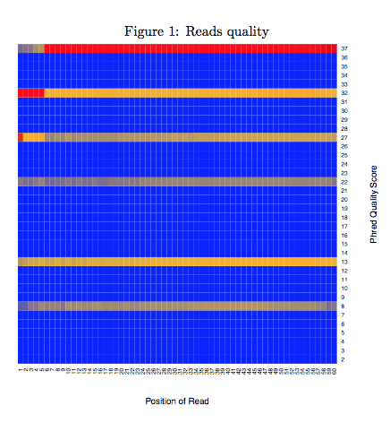
Figure1_quality_heatmap.pdf
Reads quality is one of the basic reads level quality control methods.
Color in the heatmap represented frequency of this quality score observed at this position.
Red represented higher frequency while blue was lower frequency.

Slide 6
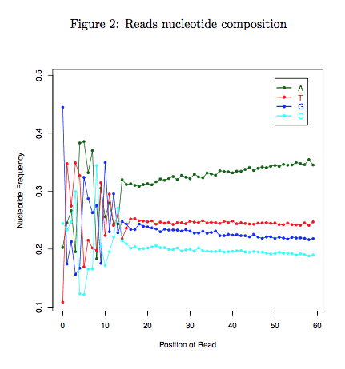
Figure2_NVC.pdf
We assessed the nucleotide composition bias of a sample.
The proportion of four different nucleotides was calculated at each position of reads.
Theoretically four nucleotides had similar proportion at each position of reads.
You may observe higher A/T count at 3’end of reads because of the 3’end polyA tail generated in sequencing cDNA libaray, otherwise the A/T count should be closer to C/G count.

Slide 7
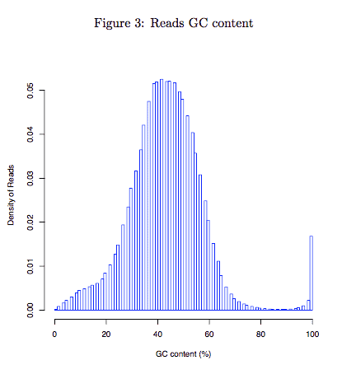
Figure3_GC.pdf
Distribution of GC content of each read. This module measures the general quality of the library.
If the distribution looks different from a single bell(too sharp or too broad) then there may be a problem with the library.
Sharp peaks on an otherwise smooth distribution are normally the result of a specific contaminant (adapter dimers for example), which may well be picked up by the overrepresented sequences module.
Broader peaks may represent contamination with a different species.

Slide 8
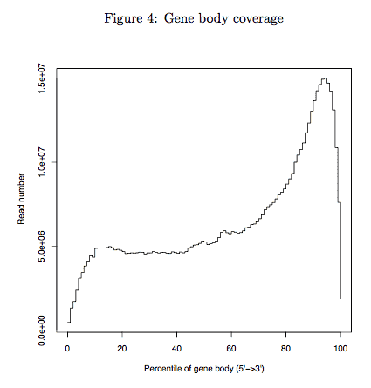
Figure4_GBcover.pdf
Aggregate plot of reads coverage on all genes. This module measures the general quality of Drop-seq data.
Theoretically we observe a unimodal(single bell) distribution, but for Drop-seq sample an enrichment at 3’end is observed due to library preparation using oligo-dT primers.
In any case you should observed a smooth distritbuion. If loss of reads or spike were observed in certain part of gene body (e.g. middle or 3’end of gene body), poor quality of your library was indicated.

Slide 9
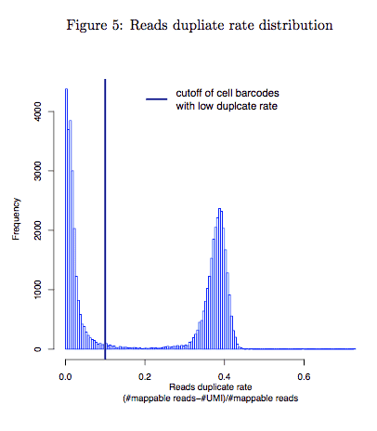
Figure5_duprate.pdf
Drop-seq technology has an innate advantage of detect duplicate reads and amplification bias because of the barcode and UMI information.
This module displays the distribution of duplicate rate in each cell barcode and helps to discard cell barcodes with low duplicate rate.
We plotted the distribution of duplicate rate in each cell barcode

Slide 10
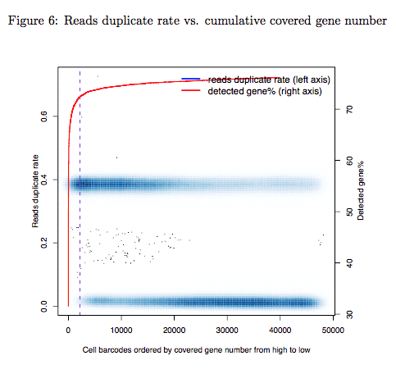
Figure6_cumUMI_duprate.pdf
Reads duplicate rate versus cumulative covered gene numbers.
This module measures whether each of your single cell was sequenced and was clearly separated from empty cell barcodes.
Cell barcodes were ranked by the number of covered genes.
The duplicate rate (y-axis, left side) was plotted as a function of ranked cell barcode. Red curve represented the number of genes covered by top N cell barcodes (y-axis, right side). N was showed by x-axis.
Theoretically you will observed a “knee” on your cumulative curve (slope = 1 on the curve) and the cutoff of your selected STAMPs (dash line) should be close to the “knee”.

Slide 11
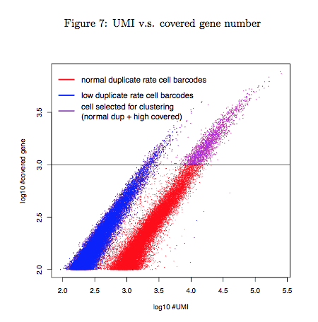
Figure7_umi_coverGN.pdf
Covered gene number was plotted as a function of the number of UMI (i.e. unique read).
This module measures the quality of Drop-seq experiment and helps to distinguish STAMPs from empty cell barcodes.
We observed a clearly different pattern for two groups of cell barcodes with different reads duplicate rate (blue dots versus red and purple dots). Purple dots represented the selected STAMPs for the cell-clustering analysis. By default we select STAMPs with 1000 gene covered after discarding low duplicate cell barcodes.

Slide 12
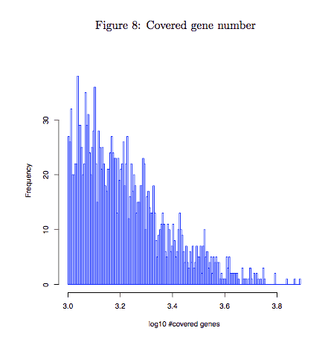
Figure8_coverGN.pdf
Histogram of covered gene number of selected STAMPs.
The module tell you whether the selected STAMPs have sufficient reads coverage. By default Dr.seq select STAMPs with cell barcodes with >= 1000 genes covered.
If you select STAMPs with highest reads count (“select cell measure” = 2), then you should check this figure to make sure the STAMPs you select have enough gene covered

Slide 13
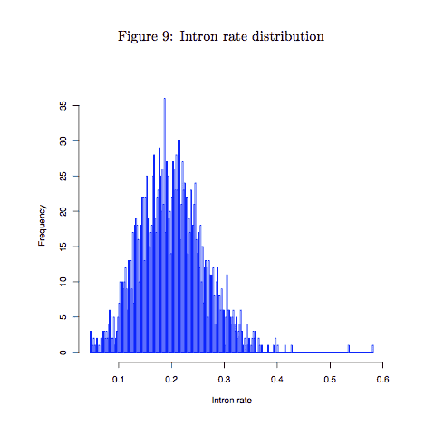
Figure9_intronrate.pdf
Intron rate is a effective method to measure the quality of a RNA-seq sample.
We plotted a histogram of intron rate of every STAMP barcodes to check whether reads from each STAMPs enriched in the exon region.
High intron rate (e.g. >= 30%) indicates low quality of cDNA in each STAMPs (the low quality could be caused by different problem, for example contaminant).
We suggest redo the Drop-seq experiment if most of selected STAMPs have high intron rate and low covered gene number.

Slide 14
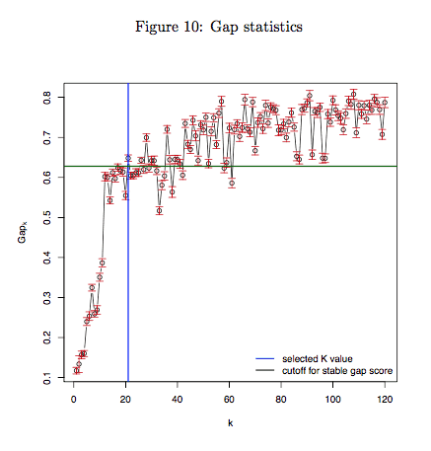
Figure10_GapStat.pdf
We conducted a k-means clustering based on t-SNE dimensional reduction output to measure sample’s ability to be separated to different cell subtypes.
Gap statistics was performed to determine the best k in k-means clustering.
In general, decreasing pattern (usually k <= 2) is observed for pure cell type or cell line data, while increasing pattern with bigger k should be observed for mix cell types (or cell subtypes) data.
If the cluster number predicted from the Gap statistics has great difference from what you expect, it indicated that your cells were not well characterized and separated by the Drop-seq experiment (because of the contaminant or the low capture efficiency of Droplets).

Slide 15
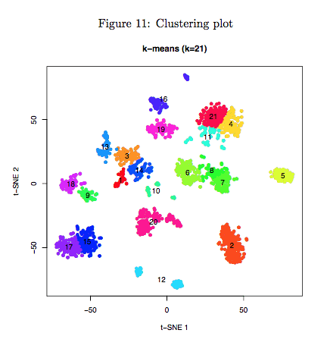
Figure11_cluster.pdf
Scatter plot represented visualization of t-SNE dimensional reduction output of selected STAMP barcodes.
STAMP barcodes were colored according to the clustering result and cluster numbers were printed in the center of each cluster.
This figure is mainly for visualization and help you to know how their data looked like. If you want to combine some small groups which are close to each other, you can use the cluster matrix (named “cluster.txt”) Dr.seq provided to conduct your own analysis.

Slide 16
Figure11_cluster.pdf
Scatter plot represented visualization of t-SNE dimensional reduction output of selected STAMP barcodes.
STAMP barcodes were colored according to the clustering result and cluster numbers were printed in the center of each cluster.
This figure is mainly for visualization and help you to know how their data looked like. If you want to combine some small groups which are close to each other, you can use the cluster matrix (named “cluster.txt”) Dr.seq provided to conduct your own analysis.

